Slide 1

Simple Calculator (Addition or Subtraction)
DLD Group Project

Slide 2
Group Member
Muhammad Subhan (20-CP-77)
Muhammad Faaz Qadeer (20-CP-52)
Umair Aziz (20-CP-47)
Muhammad Omar Farooq (20-CP-33)

Slide 3
Introduction
Welcome to our presentation
As, our Project Name is Calculator, so it performs some calculations. Our project Is capable of performing two binary operations i.e., addition and subtraction. Our project contain one 4-bit adder and one 4-bit subtractor. Both are also connected to decimal display. Here, one bit is used for performing addition or subtraction. We can say it as switch, when it is ‘0’, it performs addition and when ‘1’, it performs subtraction. In this display, it shows our binary input in decimal form. Similarly, output also contains combinational circuit which shows our output in decimal.
Our project presentation contains the truth tables, equations, and Individual circuits that shows how we had implemented our inputs and outputs. We had shown our working project test cases at the end of our presentation.

Slide 4
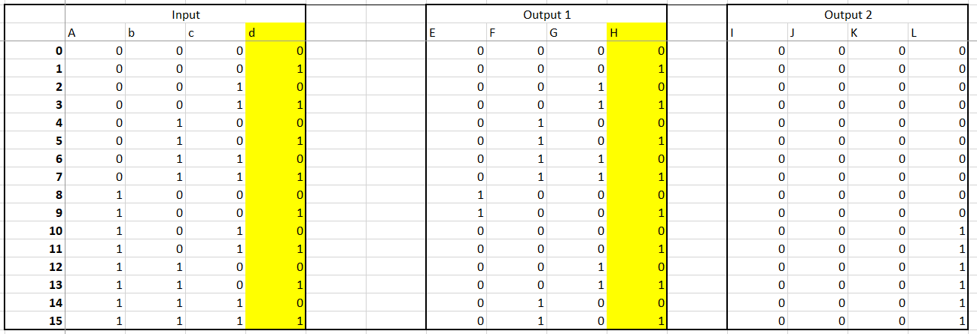
Display For Input (A)
Truth table for Input (A) and it two Output for Display.
In truth table given in Both Output. Output 1 shows 0 to 9 and Output 2 show 0 or 1. In together Display will be shown from 0 to 15.

Slide 5
Equations for Output (1)

Slide 6
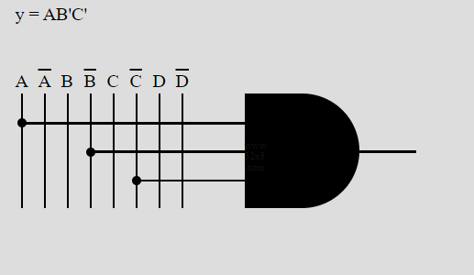
Output (1) for E
Truth table of Input (A) and it two Output. Output show 1 to 15. Output 1 will be show 0 to 9
Make K-Map and Find equation for make circuit and connect with decoder.

Slide 7
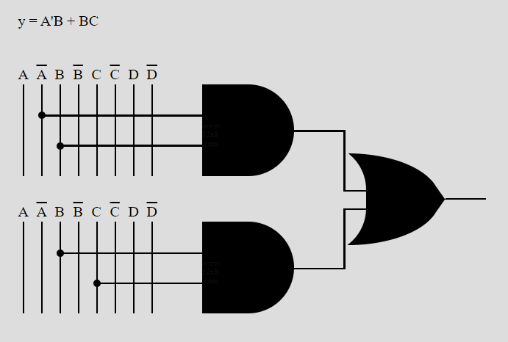
Output (1) for F
Truth table of Input (A) and it two Output. Out show 1 to 15. Output 1 will be show 0 to 9
Equation of F is shown in LCD, As we make K-Map and find the equation to make circuit and connect with 4 bit to 7 segment decoder

Slide 8
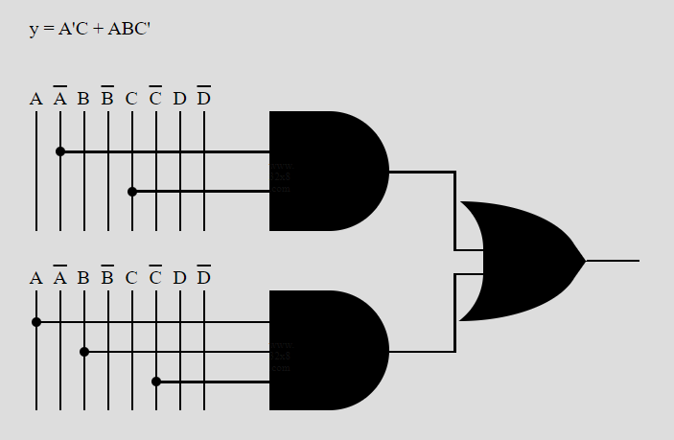
Output (1) for G
Truth table of Input(1) and it two Output. Out show 1 to 15. Output 1 will be show 0 to 9
Equation of G is shown in LCD, As we make K-Map and Find the equation to make circuit and connect with 4 bit to 7 segment decoder

Slide 9
Output (1) for H
Truth table of Input (A)
And other Input d will be same as Output H. So, this will be directly connected the decoder. Equation will be (H=d)

Slide 10
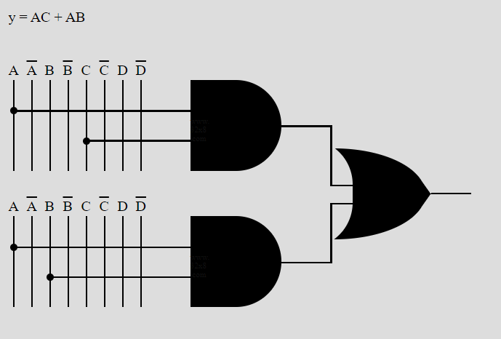
Output (2) for L
Truth table of Input (A) and it two Output. Out show 1 to 15. Output 2 will be show 0 or 1. So, other then L all will 0.
As, I=J=K=0. So, no need to make circuit.
Equation of L is shown in LCD, As we make K-Map and Find the equation to make circuit and connect with 4 bit to 7 segment decoder (2)

Slide 11
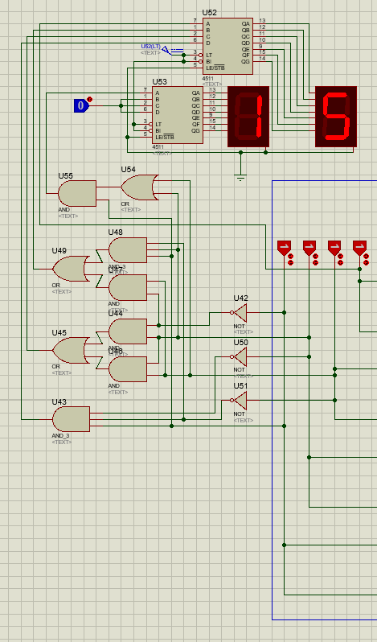
Circuit Diagram(Output A)
Take input 0 to 15 and display.
All are Output (1) or Output (2) connect together and display output together.
Input will be given from 4 Logic states of A.

Slide 12
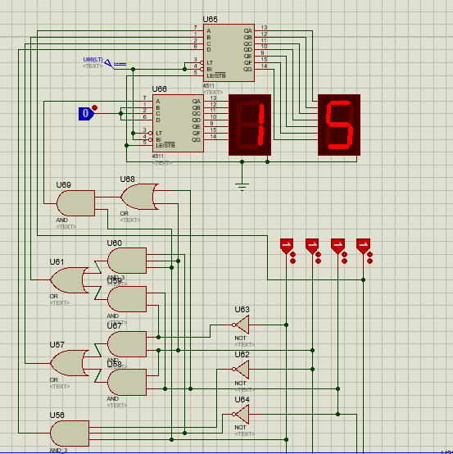
Circuit Diagram(Input B)
Take input 0 to 15 and display.
Same Functionality use in Input B. So, Circuits for Display of Input A and B is same.

Slide 13
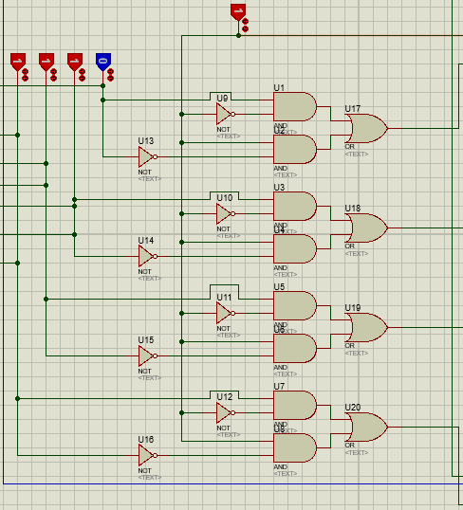
Adder Circuit
Performs the function of Addition
This circuit gets input from 0-15 and perform addition of 4-bits, so known as 4-bit adder.

Slide 14
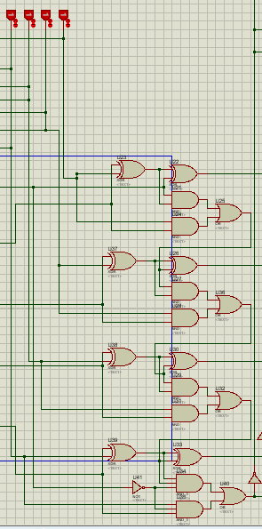
Subtracter Circuit
Performs the function of subtraction
This circuit gets input from 0-15 and perform subtraction of 4-bits, so known as 4-bit subtractor.

Slide 15
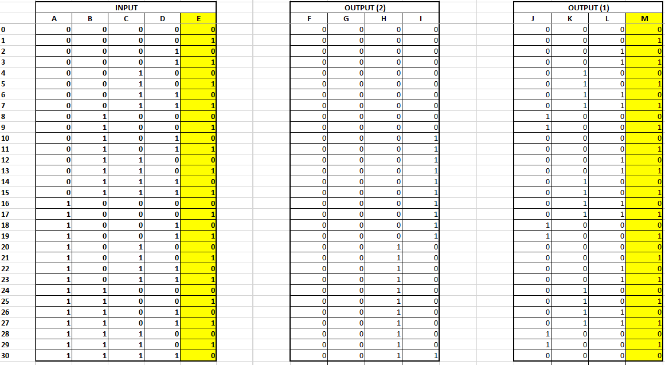
Output Display (After calculation)
Truth table of Input and it two Output. Output show 0 to 30.
As, Input is 5-bit so, we use two 4 bits outputs that are being connected to 7 segment decoder. In truth table both Outputs are given and Output 1 show 0 to 9 and Output 2 show 0 to 3. In together Output will be shown 0 to 30.

Slide 16
Equations
5-Bit Circuit Output
Calculating Equations for Displays
5 bit is then converted to two 4 bits outputs.
For display
We use BCD to 7-segment Decode IC.
Two 7-segment display

Slide 17
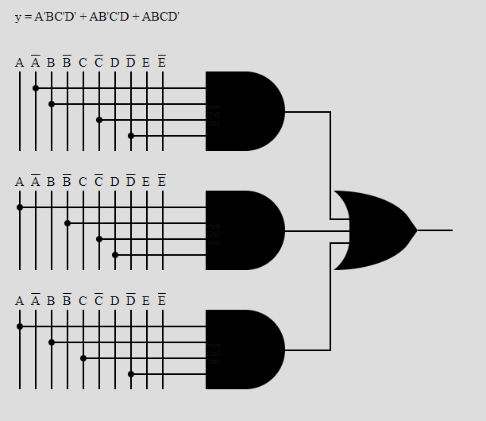
Output 1 (J)
Truth table of Input and it two Output. Out show 0 to 30. Output 1 will be show 0 to 9
Equation of J is shown in LCD, As we had made K-Map to solve this and find the equation to make circuit and connect with 4 bit to 7 segment decoder (1)

Slide 18
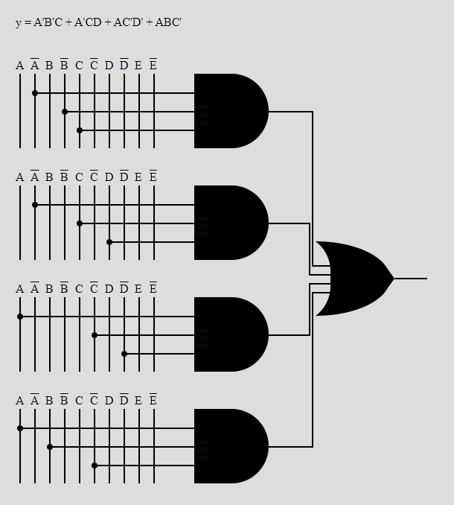
Output 1 (K)
Truth table of Input and it two Output. Out show 0 to 30. Output 1 will be show 0 to 9
Equation of K is shown in LCD, As we had made K-Map and find the equation to make circuit and connect with 4 bit to 7 segment decoder (1)

Slide 19
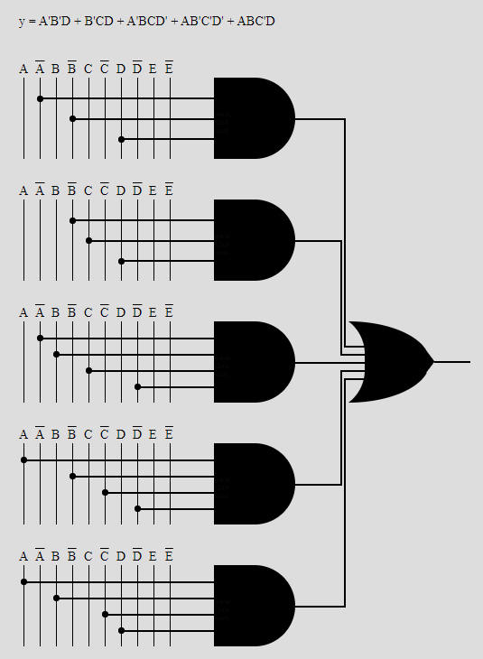
Output 1 (L)
Truth table of Input and it two Output. Out show 0 to 30. Output 1 will be show 0 to 9
Equation of L is shown in LCD, As we had made K-Map and Find the equation to make circuit and connect with 4 bit to 7 segment decoder 1

Slide 20
Output 1 (M)
Truth table of Input and it two Output. Out show 0 to 30. Output 1 will be show 0 to 9
M is equal to E. So, M is directly connected to decoder. So, equation of M=E

Slide 21
Output 2
Output 2 (G and F)
As from Given Truth Table
G = 0
F = 0
We apply 0 Logic to G, F in Decoder

Slide 22
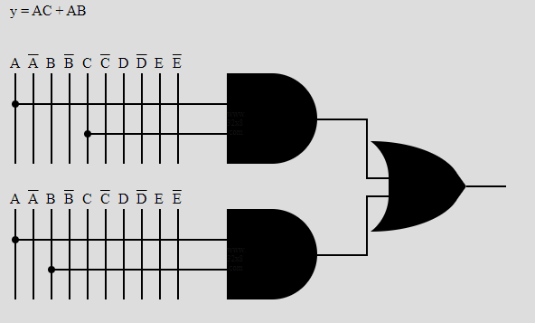
Output 2 (H)
Truth table of Input and it two Output. Out show 0 to 30. Output 2 will be show 0 to 2
Equation of H, we had made K-Map and find the equation to make circuit and connect with 4 bit to 7 segment decoder (2)

Slide 23
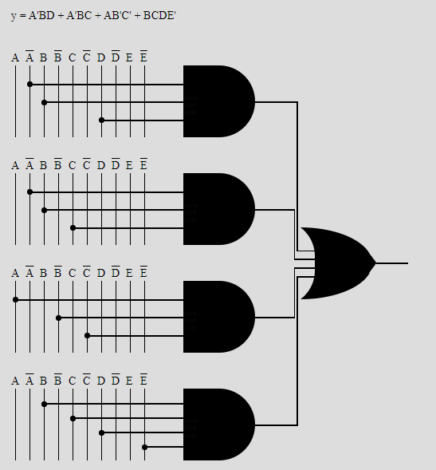
Output 2 (I)
Truth table of Input and it two Output. Out show 0 to 30. Output 2 will be show 0 to 2
Equation of I, we had made K-Map and find the equation to make circuit and connect with 4 bit to 7 segment decoder (2)

Slide 24
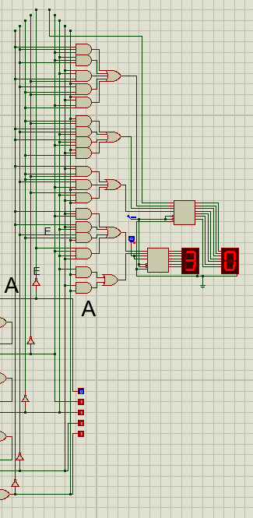
Output Circuit Diagram
Circuit that will show output 0 to30.
All are Output (1) or Output (2) connected together and display output together. Input will get 5 bits 0 or 1 form Logic Probes.

Slide 25
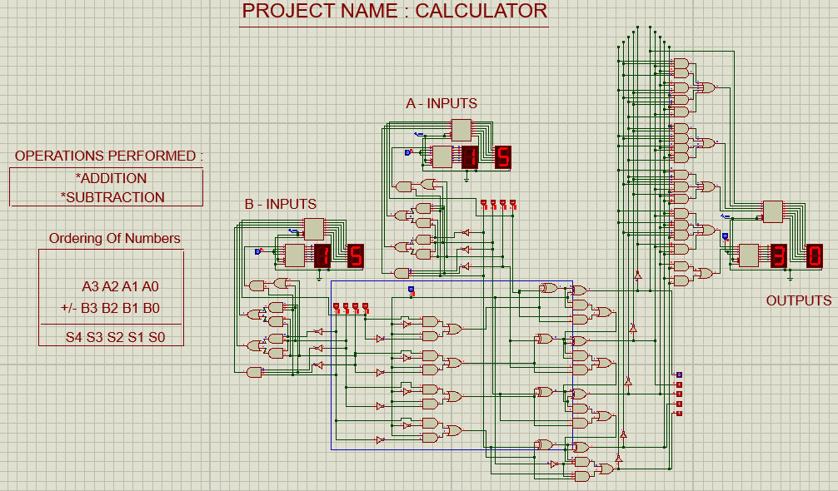
Complete Circuit Diagram
Complete Circuit Diagram after combining both Inputs, Adder and Subtracter circuit with Output.

Slide 26
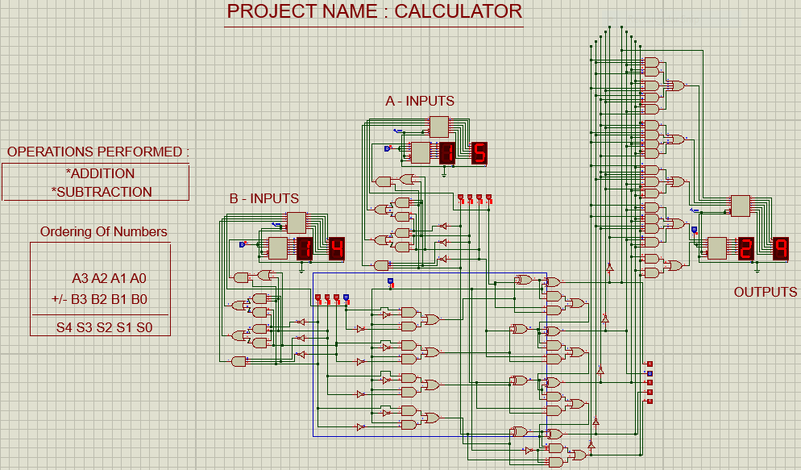
Test Case (Addition)
Addition (case 1)
15 + 14 = 29

Slide 27
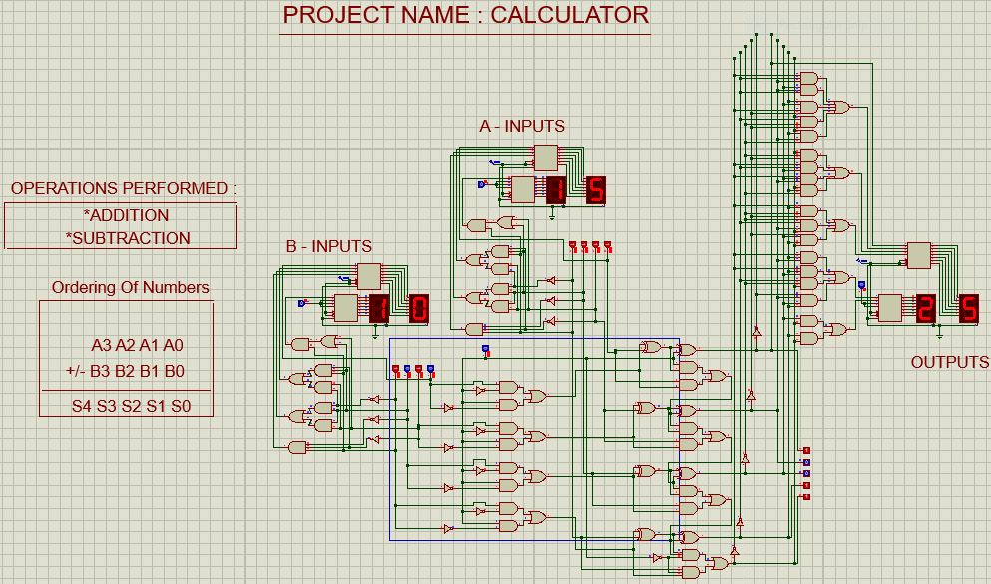
Test Case (Addition)
Addition (case 2)
15 + 10 = 25

Slide 28
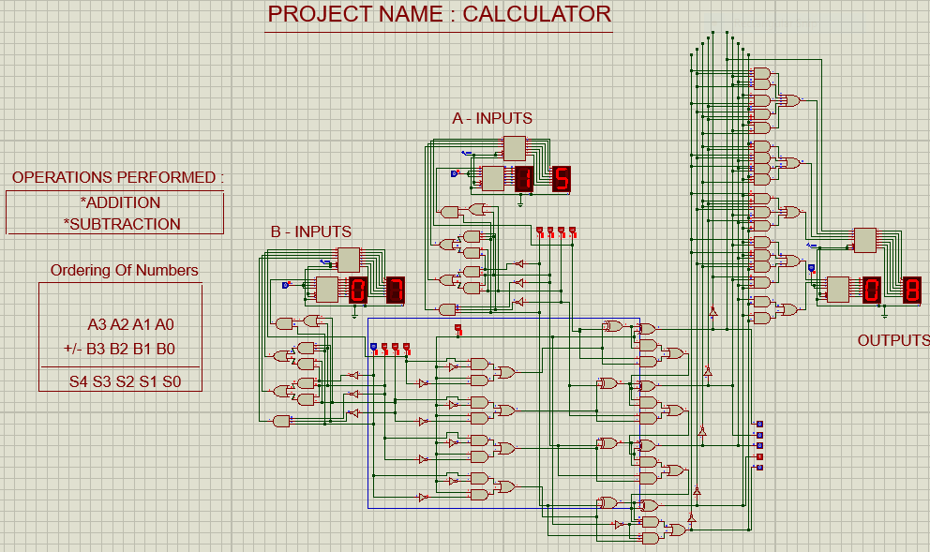
Test Case(Subtraction)
Subtraction (case 1)
15 – 07 = 08

Slide 29

Test Case (Subtraction)
Subtraction (case 2)
15 – 05 = 10

Slide 30
Explanation of Project
As we had already mentioned that this project is basically able to perform two operations ( Addition and subtraction). We had used adder and subtractor for this purpose. Both adder and subtractor are 4-bit operator. We had declared one bit as a logic state which acts like a switch. When this bit is 0, it performs addition and when this bit is 1, it performs subtraction. For display of our binary bit to decimal, we had made truth tables, solve the equations and then make a circuit that we had implemented at start of the both inputs and outputs. Addition of both inputs A and B ranges from 0-30. Addition of bits can be performed in any way but in case of subtraction, we had to subtract input-A to input-B. If we perform subtraction from Input-B to Input-A, it will show the output in the form of 2’s complement.
For example (Subtracting Input-B to Input-A):
15 In binary, 14 is equal to ‘1110’ and if we take its 1’s complement, it becomes ‘0001’ and add ’1’ in the result
-13 the answer is ‘0010’ which is equal to 02 in decimal. So, when we subtract Input-B from Input-A, the result is .14 in 2’s complement form.
This is the brief explanation of our project that how it works.
********************************

Slide 31

There are only two ways to live your life. One is as though nothing is a miracle. The other is as though everything is a miracle.

Slide 32
Thank you!
Any Questions?

